Slide 1
Phase 5
Document the machine learning model

Slide 2
machine learning model deployment objective
Introduction
Imagine that you’ve spent several months creating a machine learning (ML) model that can determine if a transaction is fraudulent or not with a near-perfect f1 score. That’s great, but you’re not done yet. Ideally, you would want your model to determine if a transaction is fraudulent in real-time so that you can prevent it from going through in time. This is where model deployment comes in.
Most online resources focus on the prior steps to the machine learning life cycle like exploratory data analysis (EDA), model selection, and model evaluation. However, model deployment is a topic that seems to be rarely discussed — the reason being is that it can be fairly complicated. Deployment is a topic that is completely unrelated from EDA, model selection, or model evaluation, and thus, it’s not well understood by those without a background in software engineering or DevOps. In this article, you’ll learn what model deployment is, the high-level architecture of a model, different methods in deploying a model, and factors to consider when determining your method of deployment.

Slide 3
Design Thinking and Machine Learning
Design thinking is defined as a human centric process that builds upon the deep understanding of the end users such as behaviours or tendencies to generate ideas or prototypes and to put out your innovative solution to the world. In future, every business should integrate design thinking and machine learning in order to take it to the next level.
Machine learning is a method of data analysis. Machine learning is a machine centred approach. In machine learning, there are algorithms we can use to make machine learn through data iteratively and make it able to find hidden insights from the data. So that, machine can itself take decisions without being explicitly programmed what to do in each case.
Design thinking is a process for creative problem solving and as AI is getting more and more advance , future business leaders should must know about how to use design thinking with machine learning in order to create better and effective solutions. Machines are better at processing data.

Slide 4
“Design thinking is a human-centred approach to innovation that draws from the designer’s toolkit to integrate the needs of people, the possibilities of technology, and the requirements for business success.”

Slide 5
Phases of Design Thinking:
Empathize
Define
Ideate
Prototype
Test

Slide 6
Phases of Machine Learning:
Analyze
Synthesize
Ideate
Tuning
Validate
Now, I am going to explain each of these phases in detail..

Slide 7
Step 1. Empathize and Analyze
The objective of ‘Empathize and Analyze is to understand your users. Who is my user? What matters to this person? In design thinking, it refers to understand and capture the user’s pain points, and trying to know as much as possible about user. In machine learning, it refers to capture the user’s key decisions and to find out the variables and metrics that might be useful for making better predictions.

Slide 8
Step 2. Define and Synthesize
In design thinking, it refers to creation of a Point Of View(POV) based on user’s needs and insights. What are their needs? What is the working environment of user? It basically refers to design, document and validate your understanding of user’s needs. In machine learning, it refers to the combination of separate elements in order to create a whole new.

Slide 9
Step 3. Ideate and Ideate
This step is all about ideation. In design thinking, it refers to brainstorm as many solutions as possible and then prioritize those solutions on the basis of business feasibility and customer values and implementation. In machine learning, it refers to playing with small sample data by applying various analytical models and algorithms in order to see what types of insights are there in the data.

Slide 10
Step 4. Prototype and Tune
In design thinking, it involves providing the working prototype to the user. This steps involves the study of user’s interactions with the product to see what works and where the users are facing problems. Identify what additional designs can be added in product in order to enhance user experience. In machine learning, identify where analytics insights are needed and what additional data you can capture. You have to explore opportunities to provide real time insights to user.

Slide 11
Step 5. Test and Validate
In design thinking, it refers to the monitoring of usage to determine the effectiveness of the product or solution. There should be a continuous improvement of the product where feedback can be quickly used to improve users experience. In machine learning, try to avoid overfitting your model. This step is also the start of the continuous improvement process from the user experience and analytic model tuning perspectives.

Slide 12
Learning Model Development and Model Operations: Principles and Practices
Introduction
The use of Machine Leaning (ML) has increased substantially in enterprise data analytics scenarios to extract valuable insights from the business data. Hence, it is very important to have an ecosystem to build, test, deploy, and maintain the enterprise grade machine learning models in production environments. The ML model development involves data acquisition from multiple trusted sources, data processing to make suitable for building the model, choose algorithm to build the model, build model, compute performance metrics and choose best performing model. The model maintenance plays critical role once the model is deployed into production. The maintenance of machine learning model includes keeping the model up to date and relevant in tune with the source data changes as there is a risk of model becoming outdated in course of time. Also, the configuration management of ML model play an important role in model management as the number of models grow. This article focuses on principles and industry standard practices, including the tools and technologies used for ML model development, deployment, and maintenance in an enterprise environment.

Slide 13
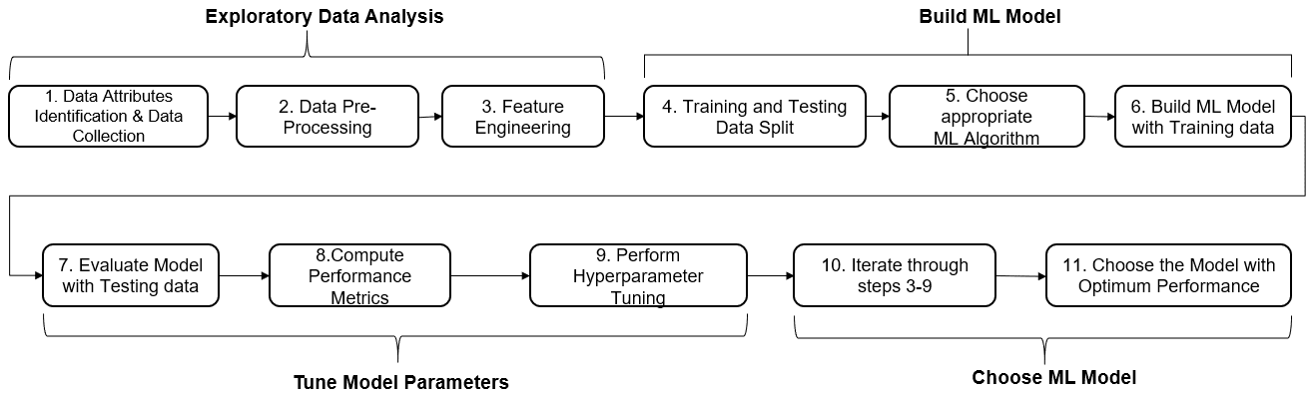
Model Development
Machine Learning (ML) Model Lifecycle refers to the process that covers right from source data identification to model development, model deployment and model maintenance. At high level, the entire activities fall under two broad categories, such as ML Model Development and ML Model Operations.

Slide 14
The ML model development lifecycle steps can be broadly classified as – data exploration, model building, model hyperparameters tuning and model selection with optimum performance.
Exploratory data analysis is an important step that starts once business hypothesis is ready. This step takes 40-50% of total project time as the model outcome depends on the quality of input data being fed to train the model. Exploratory data analysis involves data attributes identification, data preprocessing and feature engineering. Attributes’ identification involves identification of predictor/features variables (inputs) and target/class variable (output), along its data types (string or numeric or datetime) and classification of features into categorical and continuous variables that helps in applying appropriate treatment to be given to the variable by the algorithm while building the model. Data pre-processing involves identification of missing values and outliers and fill these gaps by computing mean or median for quantitative attributes and mode for qualitative attributes of data to improve the predictive power of model. The outliers cause increased mean and standard deviation, that can be eliminated by taking natural log value which reduces the variation caused by extreme values.

Slide 15
Feature Engineering is the next most important step in exploratory data analysis where the raw dataset is processed to convert data types of string or datetime or numeric ones to numeric vectors for an ML algorithm to understand and build efficient predictive model. Also, the labelled categorical data (e.g., color red, green, blue; performance → poor, fair, good, very good, excellent; risk → low, medium, high; status → started, in-progress, on-hold, closed; gender → male/female; is_loan_approved/is_claim_fraudulent → yes/no) cannot be understood by an ML algorithm in its true context, hence it is required to be converted into numeric data. Feature Encoding is the widely used technique to transform the categorical data into continuous (numerical) values, e.g., Encode color as 1,2,3; performance as 1,2,3,4,5; risk as 1,2,3; status as 1,2,3,4; gender / is_loan_approved / is_claim_fraudulent as 0/1 etc. It is recommended to use label encoding in case categorical variables have no ordered relationship (e.g., color and status), ordinal encoding in case categorical variables have an ordered relationship (e.g., performance, risk) and one hot encoding in case categorical variable data is binary in nature (e.g., gender, is_loan_approved, is_claim_fraudulent). A set of libraries are available in R or Python to implement these encoding methods. In some cases, a set of dummy variables or derived variables are created, especially in handling ‘date’ data types. Once the categorical text data is converted into numeric data, the data is ready to be fed to the model; As a last step, it is required to choose the appropriate features that help in improving the accuracy of model, by using the techniques such as Univariate Selection (statistical measure), Feature Importance (model property) and Correlation Matrix (identifies which features are most related to the target variable). These methods detect Collinearity between two variables where they are highly correlated and contain similar information about the variance within a given dataset.

Slide 16
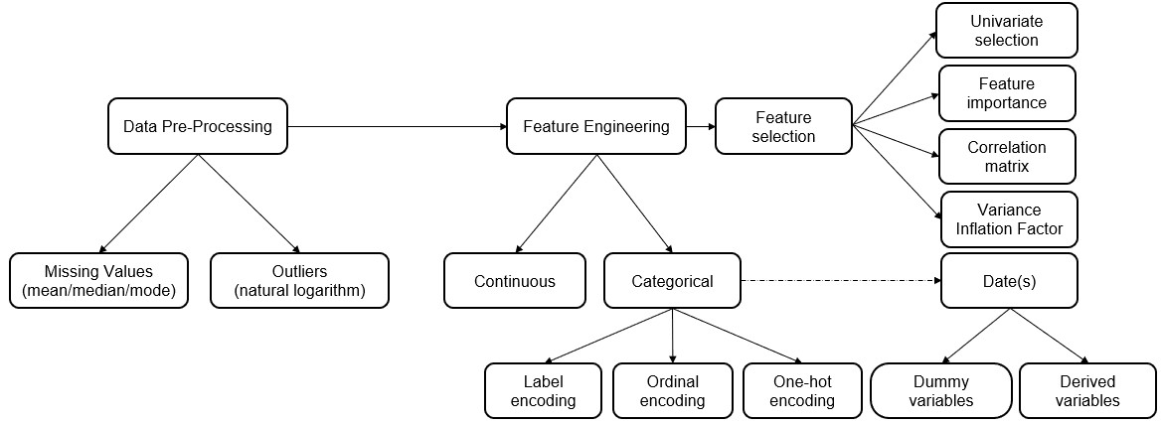

Slide 17
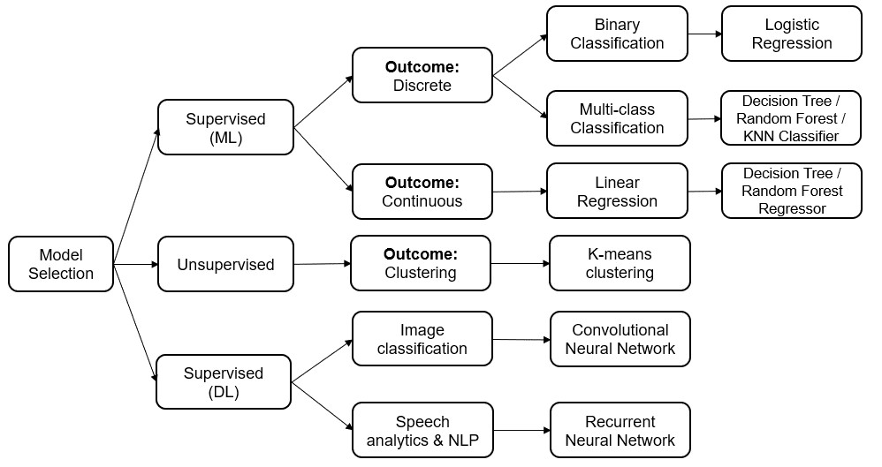

Slide 18
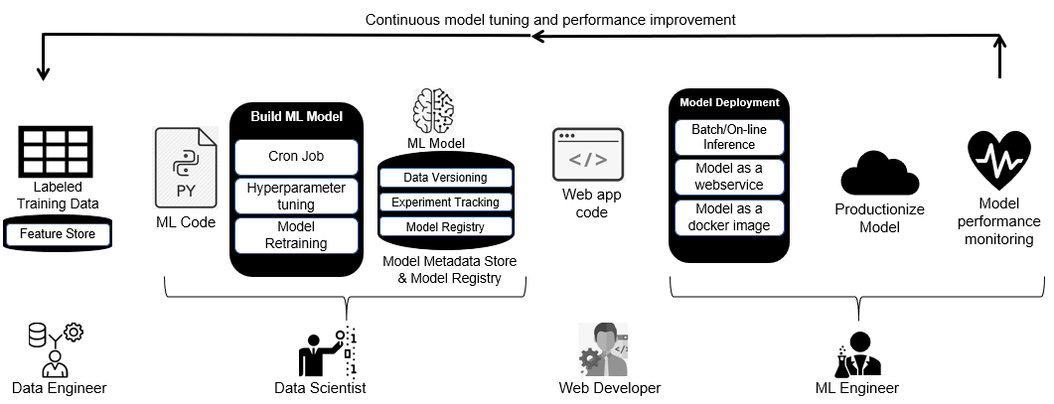
Machine Learning (ML) Model Operations Lifecyle

Slide 19
Describe the predictive use case, dataset selection, model training, deployment process, and integration steps
The primary goal of machine learning (ML) is to perform a task more efficiently using models, which only becomes possible if the ML models are available for end users. Most view ML deployment as an art, requiring careful collaboration between the data science, software engineering, and DevOps teams to deploy a model successfully. Also, because teams focus on different aspects of the model—the IT team focusing on stability, uptime, and availability of the model, while the data science team focuses on model iteration and experimentation—bridging the gap and ensuring an effective blend of these two teams might be the difference between a successfully deployed and no deployed model. A 2019 VentureBeat article reported that only 1 out of 10 data science projects successfully deploy a model and ascribe failures to three primary reasons: lack of collaboration, siloed data resulting from the complexity of data, and a lack of leadership support. But thanks to the evolution of MLOps, ML teams now approach the ML lifecycle more collaboratively. Let’s explore different methods of deploying ML models, how to select the one that’s best for your model, and how StreamSets can play a role in a successful ML strategy.

Slide 20
The Development and Training of Machine Learning Models
In ML, no model means no deployment, and the development of every model starts with the need to solve a business need/question. Knowing this business question helps align and choose an algorithm that fits the business use case. Then follows data collection, transformation and pre-processing steps, like cleaning and data wrangling. At this stage, an enterprise data integration tool like StreamSets can step in to ensure data from across your organization is pulled together, cleaned, transformed and ready for modeling. After achieving excellent data quality, model selection and training begins. The model training step is the most crucial and determines the performance and accuracy of your final ML model. The model training step involves selecting an algorithm that fits your business use case and training the algorithm on your training data set until it achieves a particular level where further training decreases accuracy or increases validation error. The model training process is iterative and experimental and involves a training loop of experimental design, model structure formulation, parameter estimation, and model validation until models achieve a minimum validation error. The iterative model training process also involves optimizing and testing model algorithms to ensure models perform optimally in production after deployment.

Slide 21
How Machine Learning Models Are Deployed
Once an ML model is ready, the next step is to make it available for users to make predictions. Placing an ML model in an environment for users to interact with and use for decision making refers to model deployment. For example, a loan application might use a model to predict a credit score for users using a set of values. Predicting the credit score can be as easy as calling this function: Prediction = classifier.predict(INPUT DATASET).

Slide 22
The Process of Deploying Machine Learning Models
ML model deployment involves the following steps: Develop, create, and test the model in a training environment: This step requires rigorous training, testing, and optimization of the model to ensure high performance in production. The model training step determines how models perform in production. ML teams must collaborate to optimize, clean, test, and retest model code. Movement of models to deployment environment: After rigorous testing and optimizing model code, the top-performing models undergo preparation for deployment. Models need a deployment environment that contains all the hardware resources and data required to make the model perform optimally. Different deployment environments include: Containers: Most teams use a container deploying environment because containers are reproducible, predictable, and easy to modify and update, making collaboration among engineers easy. Containers encompass all the hardware, configurations and dependencies necessary to deploy the model, improving consistency among ML teams. Notebooks: Jupyter and AWS Sagemaker are common notebooks used by data scientists for experimentation in the ML lifecycle. However, notebooks present difficulties like reproducibility and testing for teams. To efficiently use notebooks in the production workflow, teams should consider code organization, reusability, and dependencies, among other factors. In-App environments: This environment works when certain limitations or constraints exist around using data outside the application. Making models available for end users: ML teams must choose how to make models available for their users. Most can be available on demand or deployed to edge devices. Monitoring: The ML lifecycle continues after deployment. Deployed models must undergo constant monitoring to evaluate the performance and accuracy of models over time. Because data is in a continual state of motion and change, model degradation may occur. In this case, automating the ML workflow to monitor and retrain models constantly helps ensure the longevity of models.

Slide 23
Four Ways You Can Deploy ML Models Into Production
Deploying ML models into production can follow various methods, each with its merits. Let’s explore some popular ML deployment methods: On-demand prediction mode: This deployment mode means users offer input on a model and receive predictions immediately, in real-time. Although this deployment method offers prediction on demand, it confers on prediction results an inherent latency, which limits the type of models it can utilize. This inherent latency means real-time prediction deployment can’t deploy complex models. Batch prediction: Also referred to as offline model deployment, this deployment method runs periodically and returns results only for the new data generated since the previous run. Most batch predictions use ETL processes to fetch pre-calculated features from feature stores to use an input for the prediction model. It works for cases where real-time predictions aren’t a priority. The batch method offers the advantage of its ability to perform more complex predictions and handle a high volume of instances. It also eliminates the constant worry of scaling or managing servers to handle peak demands, as seen in real-time prediction. Deployment using a web service: This method is the simplest and deploys the model as a web service, by building a REST API and using the API in mobile or web applications for users. Deployment as web services mainly serves ML teams with multiple interfaces like web, mobile, and desktop. Standard technologies that power web-service prediction models include AWS Lambda and Google cloud functions, docker containers, or notebooks like Databricks. Deploying on edge devices as embedded models: Edge computing has recently become popular for its improved latency and reduced user bandwidth. This improved performance results from placing compute resources and devices close to the user. However, because of the limited size of hardware, compute power, and storage capacity of most edge-computing devices, deploying ML models directly on devices isn’t practical. However, aggregation and quantization processes in tools like the TensorFlow Lite library help simplify the models for successful deployment on edge and IoT devices.

Slide 24
Considerations for Deploying Machine Learning Models
ML teams must carefully consider these factors before deciding on a deployment model that works: Frequency of predictions: knowing how often your model will generate predictions helps allocate resources like computing and storage to serve the model. Time-consciousness of prediction results: This helps decide between a real-time or batch method. For example, some services, like logistics or estimated delivery time for food, will benefit from a real-time prediction model, which improves the customer experience. Other services, like equipment maintenance, can use a batch prediction method whereby ML models batch maintenance metrics to inform on faults or those needing servicing. Computational power and load implications: Real-time predictions require setting up a plan to handle peak load while ensuring optimum performance while in use and achieving the set SLA. Preparing for peak loads may involve acquiring additional compute resources, which means more cost. On the other hand, handling load is more flexible for batch predictions as models compute predictions over a time batch. Hardware and infrastructural responsibility: Real-time prediction deployments create additional responsibility for ML teams as models need constant monitoring for performance checks to detect any drop in performance or issues. On the other hand, although batch predictions still need continuous monitoring, there is less responsibility, as there is less urgency in fixing any problems. The complexity of the model: Regression algorithms like linear and logistic regression are not complex to execute and do not require significant computing power, so using them for real-time predictions work. For more complex models like neural networks that require considerable time and computing power to churn predictions, deploying real-time models would mean more cost and increased latency.

Slide 25
ML Model Deployment and the Cloud
Machine learning uses a significant amount of computing power, storage, and multiple servers for training and churning out predictions, which can be expensive to set up. However, the flexibility of the cloud makes ML adoption easier because organizations can quickly spin up compute and server resources to train, experiment, and deploy models—and shut these resources down when they’re not in use. This ease of use promotes experimentation and innovation for more ML products and services. StreamSets enables ML teams in a few different ways. First, by providing a platform to integrate and transform data quickly to populate models and then by connecting to popular machine learning tools to automatically and simply flow data through pre-trained models. For example, the TensorFlow Evaluator allows you to use pre-trained ML models to generate predictions without the need to write custom code. Finally, StreamSets offers advanced monitoring that can automatically detect changes flowing through models and data integration pipelines and offer alerts, workflows and reporting that keeps pipelines up and running for longer. StreamSets can be a successful partner in a long term ML strategy in a variety of ways.

Slide 26
Integration steps
Real-time (online) inference processes input data as it’s received, often with a low-latency requirement. Low latency is important for applications that require immediate responses, such as fraud detection, speech recognition, or recommendation systems. Real-time inference is more complex and expensive to implement than batch inference because it requires a faster and more reliable infrastructure. The underlying compute for real-time inference usually runs continuously to service requests faster.

Slide 27
Batch (offline) inference processes a large batch of input data at once rather than processing each input data point individually in real time. Batch inference is well suited for large data volume scenarios that need efficient processing but response time isn’t critical. For example, you might use batch inference to process a large dataset of images, and the machine learning model makes predictions on all the images at once. Batch inference is less expensive and more efficient than real-time inference. The underlying compute for batch inference usually runs only during .
Ensure consistency. It’s important to deploy your model consistently across environments, such as development, staging, and production. Use containerization or virtualization technologies, such as Machine Learning environments, to provide consistency and to encapsulate your environment.

Slide 28
Monitor performance. After your model deploys into production, you should track metrics, such as accuracy, latency, and throughput, and set up alerts to notify you when performance falls below acceptable levels. Use Application Insights and the built-in monitoring capabilities of managed endpoints to view metrics and create alerts.

Slide 29
Create a plan for updates. Machine learning models need updates as new data and new algorithms become available. It’s important to create a process to test and validate the updated model before deploying it in production. Blue/green deployment is a common strategy that updates machine learning models in production. With blue/green deployment, you can update a model to a new environment, test it, and then switch to the new model after it’s validated. Blue/green deployment ensures that potential issues with the updated model don’t affect your customers.

Slide 30
PHASE -5 (PROJECT)
Name:V.Priyadharshini
Year:3rd(5th)sem
Department:CSE
College: University College of Engineering Thirukkuvalai

